Slide 1
Containers
Week 2
CLO835, Fall 2022

Slide 2
Agenda
Dockerfile
Create Docker Images
Publish Docker Images with Amazon ECR
Docker Images

Slide 3
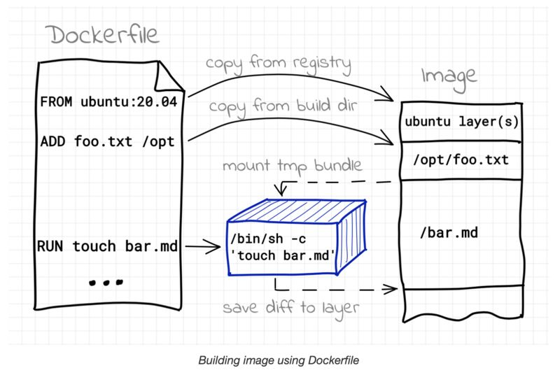
Building Docker Image
Notes:
https://iximiuz.com/

Slide 4
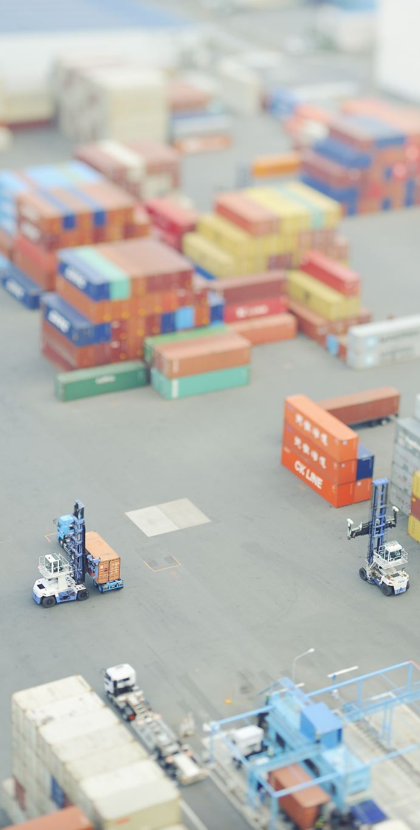
The EXPOSE instruction
The EXPOSE instruction tells Docker what ports are to be published in this image.
EXPOSE 8080
EXPOSE 80 443
EXPOSE 53/tcp 53/udp
All ports are private by default.
Declaring a port with EXPOSE is not enough to make it public.
The Dockerfile doesn't control on which port a service gets exposed.

Slide 5

Exposing ports
When you docker run -p <port> ..., that port becomes public.
(Even if it was not declared with EXPOSE.)
When you docker run -P ... (without port number), all ports declared with EXPOSE become public.
A public port is reachable from other containers and from outside the host.
A private port is not reachable from outside.

Slide 6
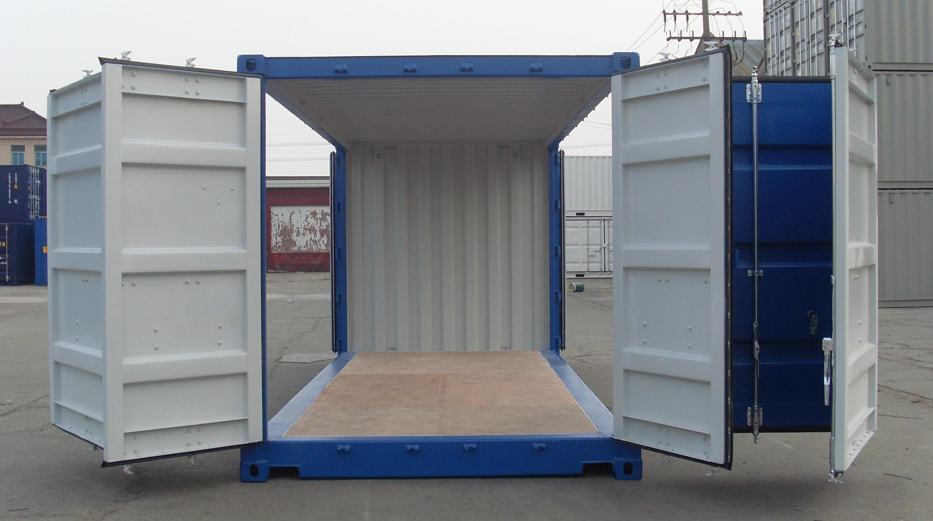
CMD and ENTRYPOINT
Notes:
In this lesson, we will learn about two important Dockerfile commands:
CMD and ENTRYPOINT.
These commands allow us to set the default command to run in a container.

Slide 7
Adding CMD to Dockerfile
CMD defines a default command to run when none is given.
It can appear at any point in the file.
Each CMD will replace and override the previous one.
As a result, while you can have multiple CMD lines, it is useless.
FROM ubuntu
RUN apt-get update
CMD sleep 20

Slide 8
Adding ENTRYPOINT to the Dockerfile
Our new Dockerfile will look like this:
FROM ubuntu
RUN apt-get update
ENTRYPOINT [”sleep”]
ENTRYPOINT defines a base command (and its parameters) for the container.
The command line arguments are appended to those parameters.
Like CMD, ENTRYPOINT can appear anywhere, and replaces the previous value.
Why did we use JSON syntax for our ENTRYPOINT?

Slide 9
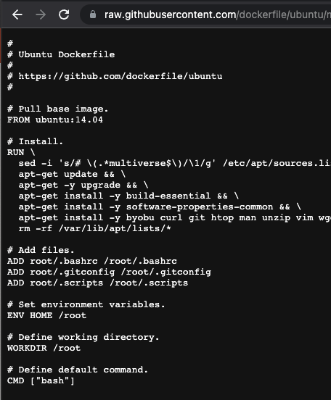
CMD vs Entrypoint
The default process invoked by Ubuntu container is bash.
If we specify the command at a runtime, the original CMD instruction is replaced if CMD is used in Dockerfile.
If we specify the command at a runtime, the command line parameter is appended to the ENTRYPOINT instruction in the Dockerfile.
Notes:
https://github.com/dockerfile/ubuntu/blob/master/Dockerfile

Slide 10

Using Environment Variables
Example of MySQL image on DockerHub
https://hub.docker.com/_/mysql
Start a mysql server instance
Starting a MySQL instance is simple:
$ docker run --name some-mysql -e MYSQL_ROOT_PASSWORD=my-secret-pw -d mysql:tag
Where:​
some-mysql is the name you want to assign to your container,​
my-secret-pw is the password to be set for the MySQL root user ​
tag is the tag specifying the MySQL version you want. ​
​

Slide 11
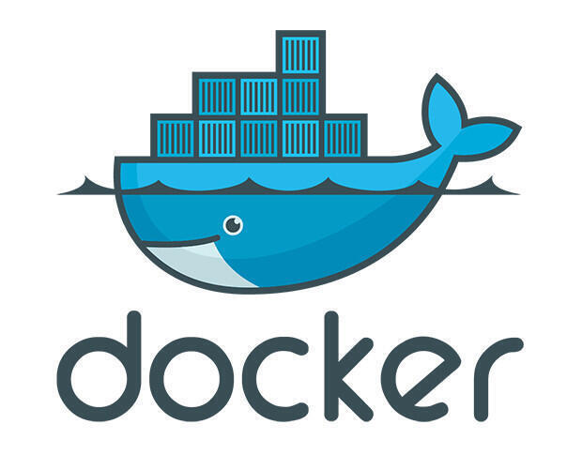
Week 2, Lab1– Environment Variables, CMD and ENTRYPOINT

Slide 12
Why and How are we going to create a Docker Image
Why? We want to containerize custom Python Flask application
How?
Start from the vanilla Ubuntu image
Update apt
Use apt to install relevant packages
Use pip to install Python application dependencies
Copy source code to /opt folder
Run the simple web server using flask command
Notes:
https://github.com/jpetazzo/container.training/blob/main/dockercoins/rng/rng.py
https://hub.docker.com/_/mysql

Slide 13
Create Dockerfile and build Docker image
git clone https://github.com/mmumshad/simple-webapp-color.git
cd simple-webapp-color/
# Create Dockerfile with the content below
FROM ubuntu:18.04
RUN apt-get update && apt-get install -y python python-pip
RUN pip install flask
# Mind the space beetween . and /opt/
COPY . /opt/
ENV APP_COLOR=red
ENTRYPOINT FLASK_APP=/opt/app.py flask run --host=0.0.0.0 --port=8080
Explain: What is the purpose of COPY directive in the Dockerfile above?
Why are the advantages of using ENTRYPOINT in place of CMD in the Dockerfile above?

Slide 14
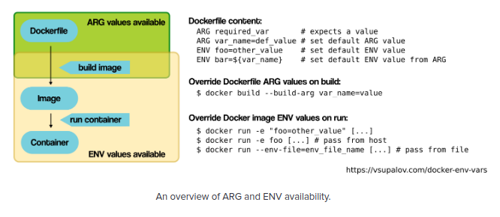
Provide Values to Container using Environment Variables
# Build docker image
$ docker build -t color_app .
# List docker images
$ docker images
# Create a container – can we access the app?
$ docker run –d -e APP_COLOR=blue color_app
# Create a container and publish the port
$ docker run –d -e APP_COLOR=blue –p 80:8080 color_app
# Verify that you can access the application locally via "curl localhost" command and from you browser using public IP of your Cloud9 environment
# Make sure to open relevant port in the Security Group
# Add screenshots of application responses to your report
Notes:
https://github.com/didier-durand/microservices-on-cloud-kubernetes

Slide 15
Environment Variables of a Running Container
# Examine environment variables of the container using "docker inspect <container id> command
$ docker inspect <container id>
Explain using the color_app example:
How is the value of APP_COLOR environment variable made available to flask application?
Is it enough specifying the environment variable in the Docker file or should it be mentioned in the application code as well?

Slide 16
Environment Variables of the Official Image
# Try running mysql container using official image
$ docker pull mysql
$ docker run –d mysql
# Adding environment variables, re-running
$ docker run --name some-mysql -e MYSQL_ROOT_PASSWORD=my-secret-pw -d mysql
# Checking the image configuration
$ docker ps
$ docker inspect <container id>

Slide 17
CMD vs Entrypoint, continued
# Overriding the CMD instruction
$ docker run ubuntu ls
# Create a new with ENTRYPOINT instruction
FROM ubuntu:16.04
ENTRYPOINT ["ls"]
$ docker build –t ubuntu-ls .
$ docker run ubuntu-ls /etc
$ docker run ubuntu-ls ls /etc
# Explain the reason this command reports an error
# Would the command error out if we replace ENTRYPOINT with CMD? Explain.

Slide 18
Week2, Lab1 – The End

Slide 19
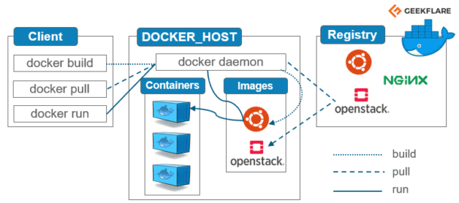
Publishing Docker Images

Slide 20
Docker Registry
These are public or private stores used to upload or download docker images
Docker registries hold images
It serves a collection of docker images created and shared by you or other docker registry users
Docker registries are the distribution component of Docker

Slide 21
Image Tags and Registry Addresses
Docker images tags are like Git tags and branches.
They are like bookmarks pointing at a specific image ID.
Tagging an image doesn't rename an image: it adds another tag.
When pushing an image to a registry, the registry address is in the tag.
Example: registry.example.net:5000/image
What about Docker Hub images?
ubuntu is, in fact, library/ubuntu, i.e. index.docker.io/library/ubuntu
# Tagging and publishing Docker image
docker tag <registry>/<user>/<image>:clo835-week2
docker push <registry>/<user>/<image>:clo835-week2

Slide 22
Week 2, Lab2– Building and Publishing Docker Images

Slide 23
Workshop Flow
1
2
3
4
Build docker images for web server, app server and PostgreSQL db
Run each of the components locally as docker containers
Create Amazon ECR repositories
Push the images to Amazon ECR

Slide 24
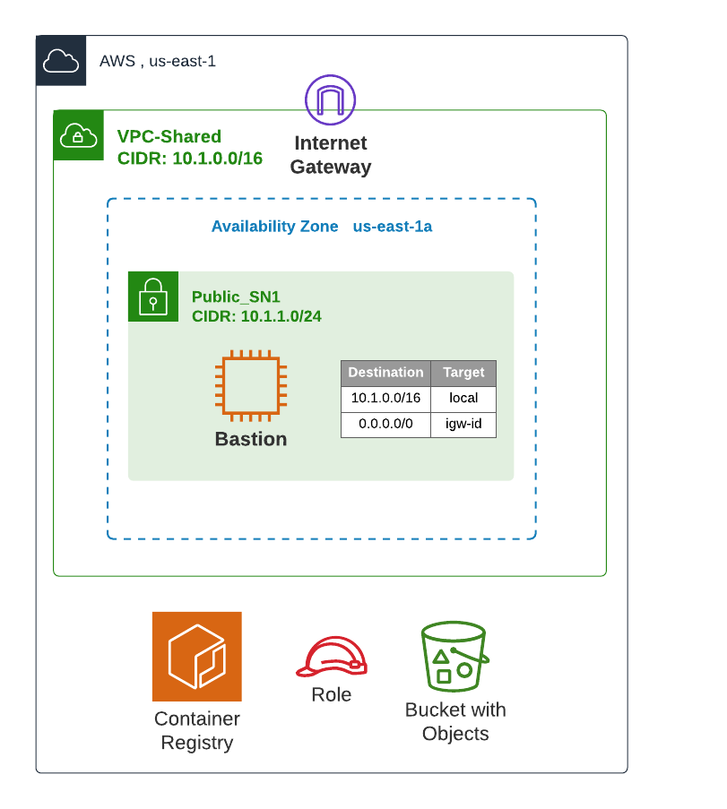
Architecture Diagram

Slide 25
Creating a Simple Flask Web Application
Clone
Clone application repo: https://github.com/mmumshad/simple-webapp-flask
Create
Manually create a script that will result in a running application inside vanilla ubuntu containers.
Convert
Convert this script to a Dockerfile
Build
Build the Docker image using Docker file
Test
Test the application locally
Publish the image
Push to Amazon ECR

Slide 26


Clone the Application Repo and Create a Script
# Install git
$ sudo yum install git -y
# Clone the repo
$ git clone https://github.com/mmumshad/simple-webapp-flask && cd simple-webapp-flask/
# Run ubuntu container in an interactive mode
$ docker run –it ubuntu bash
# Install python and pip inside the ubuntu container. Notice that you run as a root user
root@3ed51fd4362c:/# apt-get update
root@3ed51fd4362c:/# apt-get install python-pip -y
root@3ed51fd4362c:/# apt-get install pip –y
# Install flask using python package manager
root@3ed51fd4362c:/# pip install flask
# Copy the code of app.py into /opt folder and start the webserver. Use CTRL+D to save and exit
root@2946eb4d0d81:/# cat > /opt/app.py
root@2946eb4d0d81:/# cd /opt
root@2946eb4d0d81:/# FLASK_APP=app.py flask run --host=0.0.0.0
# Open another terminal and send HTTP request
$ curl http://172.17.0.2:5000

Slide 27
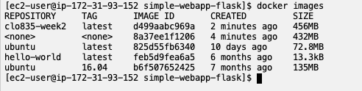
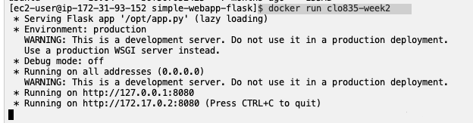
Converting the Script to a Dockerfile. Build Docker image
# Try building the original Dockerfile from the repo. Is it successful?
# Let’s fix it with the new Dockerfile definition
FROM ubuntu:22.04
RUN apt-get update && apt-get install -y python-pip
RUN apt-get install -y pip
RUN pip install flask
COPY app.py /opt/
ENTRYPOINT FLASK_APP=/opt/app.py flask run --host=0.0.0.0 --port=8080
# Build Docker image
$ docker build . –t clo835-week2
# List images
$ docker images
# Run the container
$ docker run clo835-week2
# Test locally using container IP
$ curl 172.17.0.2:8080

Slide 28
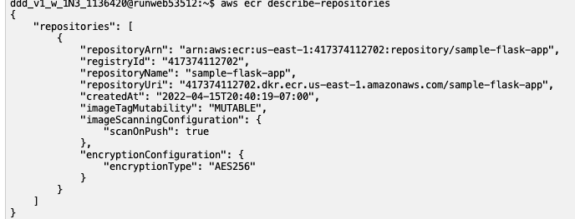
Publish Docker image to Amazon ECR
aws ecr create-repository --repository-name sample-flask-app --image-scanning-configuration scanOnPush=true
# Find the docker repo name
aws ecr describe-repositories
# Export docker repo name, replace with your account id
export ECR="417374112702.dkr.ecr.us-east-1.amazonaws.com/sample-flask-app"
export REPO_NAME=sample-flask-app

Slide 29
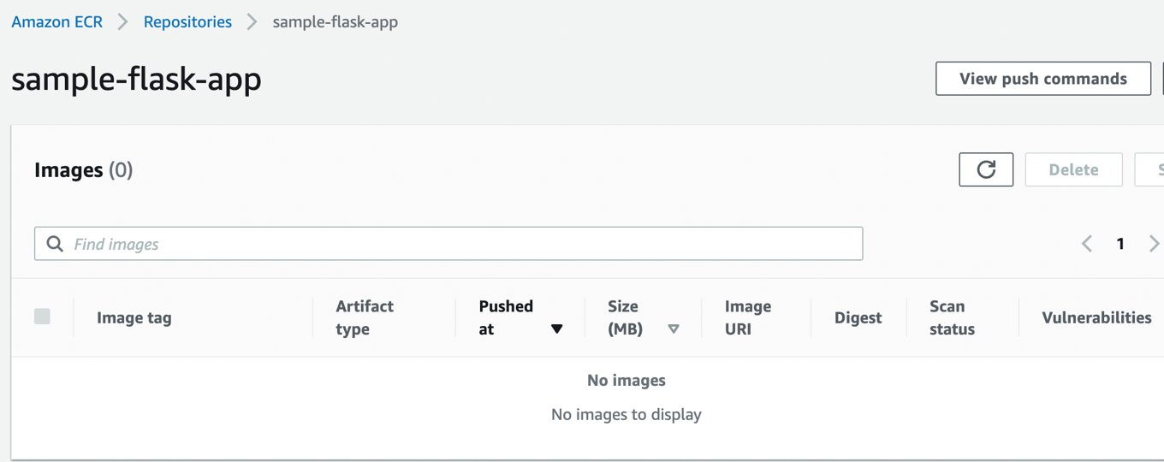
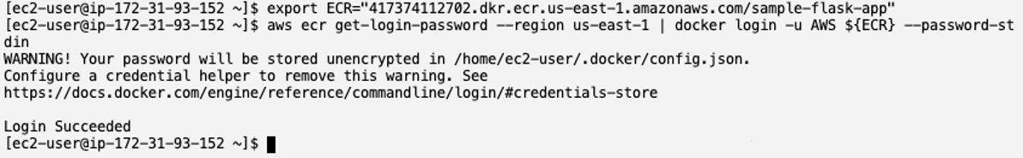
Authenticate to Amazon ECR
# Authenticate to Amazon ECR, replace with your Account id
# The easiest way is to copy this command from the ECR blade in AWS Management Console
aws ecr get-login-password --region us-east-1 | docker login -u AWS ${ECR} --password-stdin

Slide 30
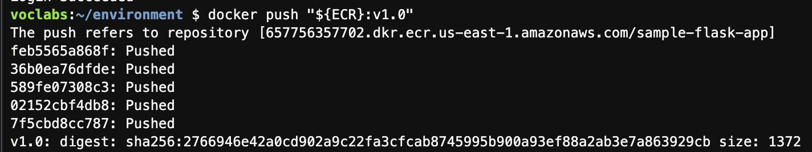
Publish the Image To Amazon ECR
# Tag the docker image
$ docker tag clo835-week2 "${ECR}:v1.0"
# List docker images in your local environment
$ docker images
# Publish docker image in Amazon ECR
$ docker push "${ECR}:v1.0”
# List images in Amazon ECR repo to verify your image was published
$ aws ecr list-images --repository-name ${REPO_NAME}

Slide 31
Week 2, Lab2 – The End

Slide 32
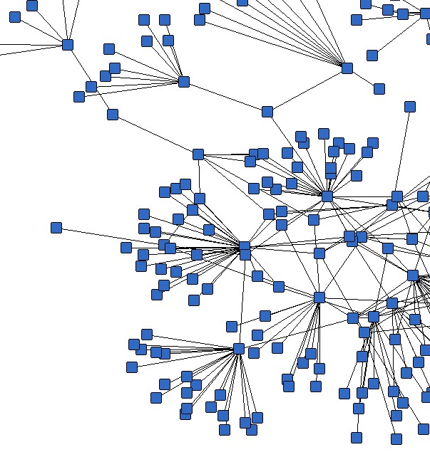
Container Networking Basics Containers Networking is Simple! Just kidding, it's not..

Slide 33
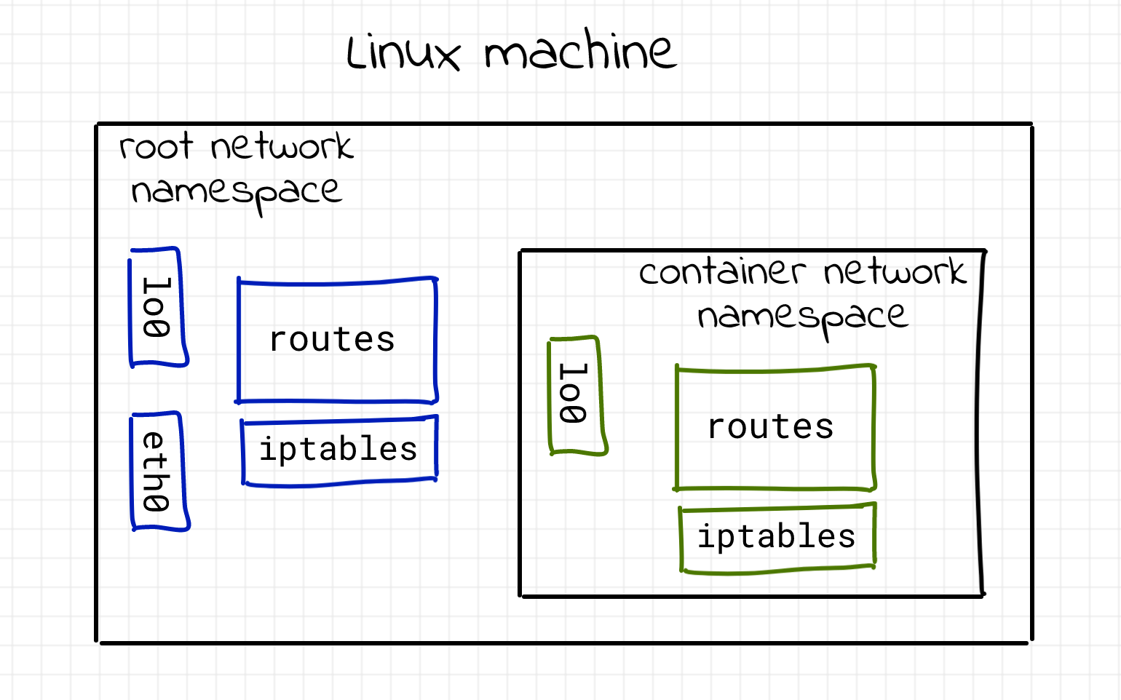
Container Newtork Namespace

Slide 34
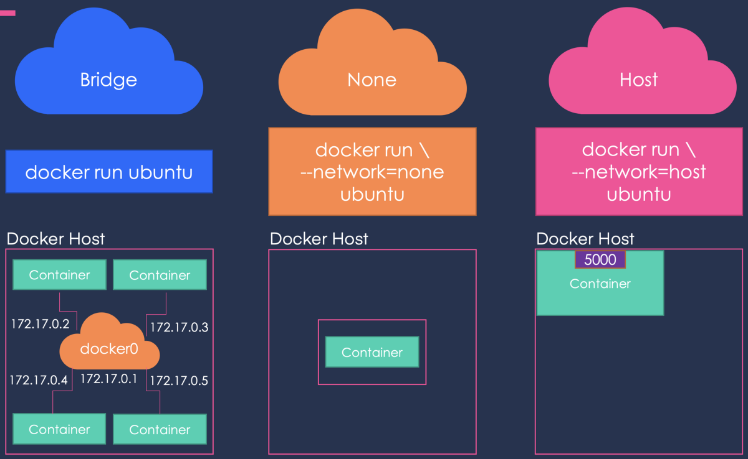
Containers Network Drivers
When we install Docker, it comes with the drivers that support the networks below
bridge (default)
null
host
New network is created with docker network create
The network is selected with docker run --net ....
Each network is managed by a driver.
Notes:
https://www.google.com/url?sa=i&url=https%3A%2F%2Ftowardsdatascience.com%2Fdocker-networking-919461b7f498&psig=AOvVaw1-oGkTr5H1fcSzgh4473or&ust=1650938911037000&source=images&cd=vfe&ved=0CA0QjhxqFwoTCJCI4-6QrvcCFQAAAAAdAAAAABAD

Slide 35
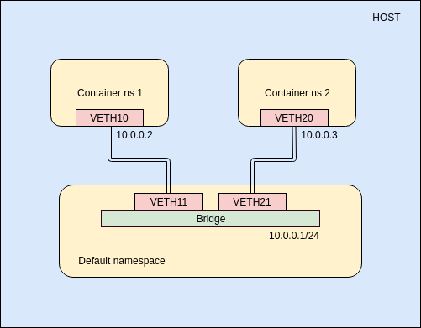
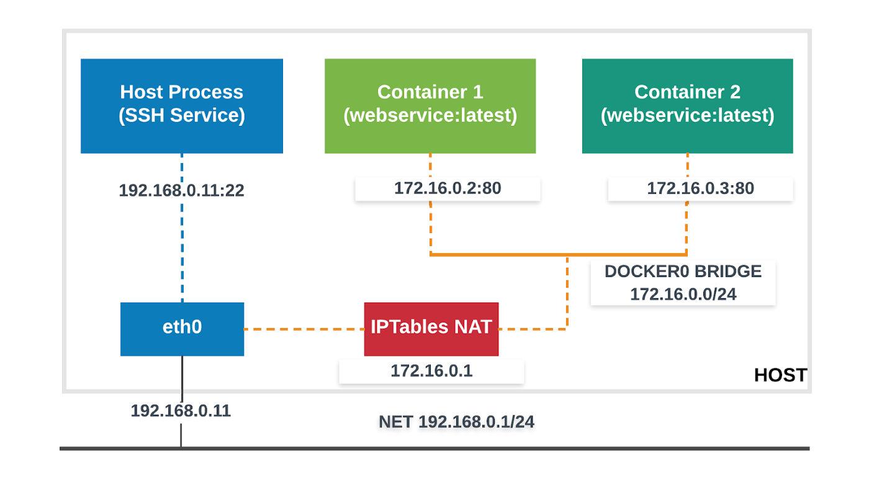
The Default Bridge
By default, the container gets a virtual eth0 interface. (In addition to its own private lo loopback interface.)
That interface is provided by a veth pair.
It is connected to the Docker bridge. (Named docker0 by default; configurable with --bridge.)
Addresses are allocated on a private, internal subnet. (Docker uses 172.17.0.0/16 by default; configurable with --bip.)
The container can have its own routes, iptables rules, etc.
Notes:
https://medium.com/@arpitkh96/basics-of-container-networking-with-linux-part-1-3a3cdc64c87a
https://medium.com/@arpitkh96/basics-of-container-networking-with-linux-65607ea2377c
https://medium.com/@arpitkh96/basics-of-container-networking-with-linux-part-3-3e236a4643b7

Slide 36
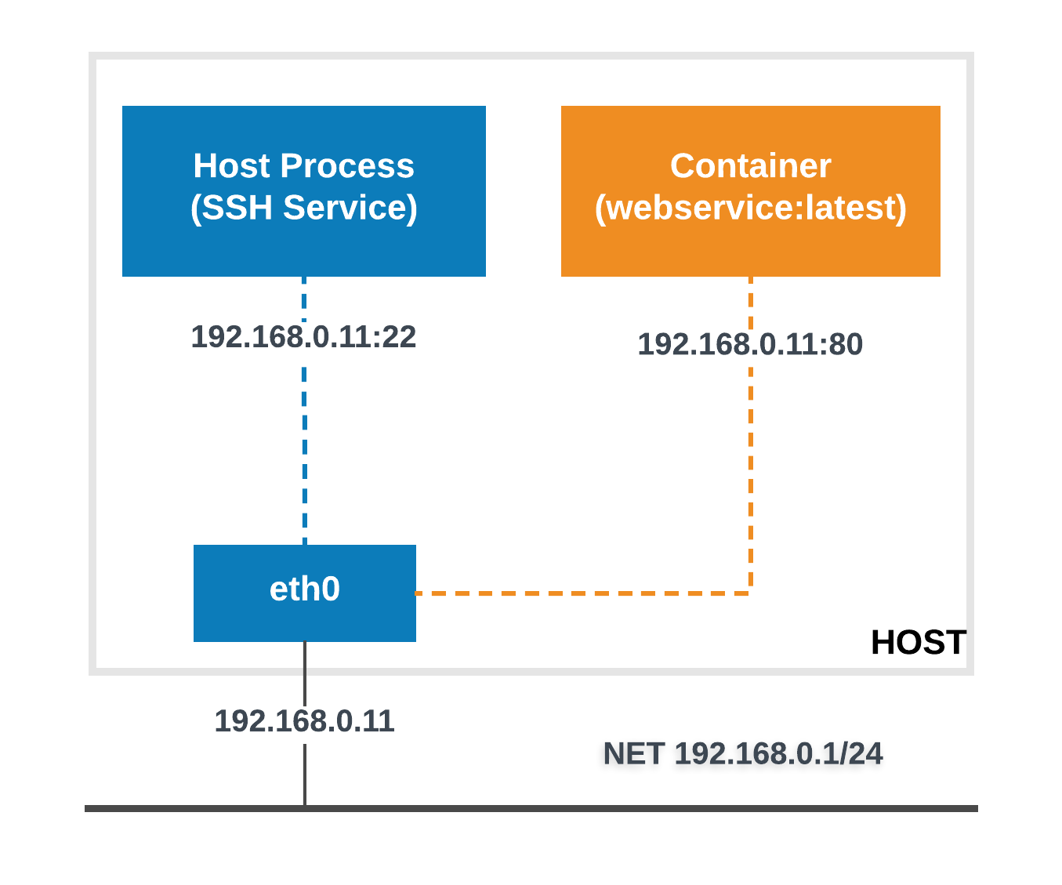
The Host Driver
Container is started with docker run --net host ...
It sees (and can access) the network interfaces of the host.
It can bind any address, any port (for ill and for good).
Network traffic doesn't have to go through NAT, bridge, or veth.
Performance = native!
Use cases:
Performance sensitive applications (VOIP, gaming, streaming...)

Slide 37
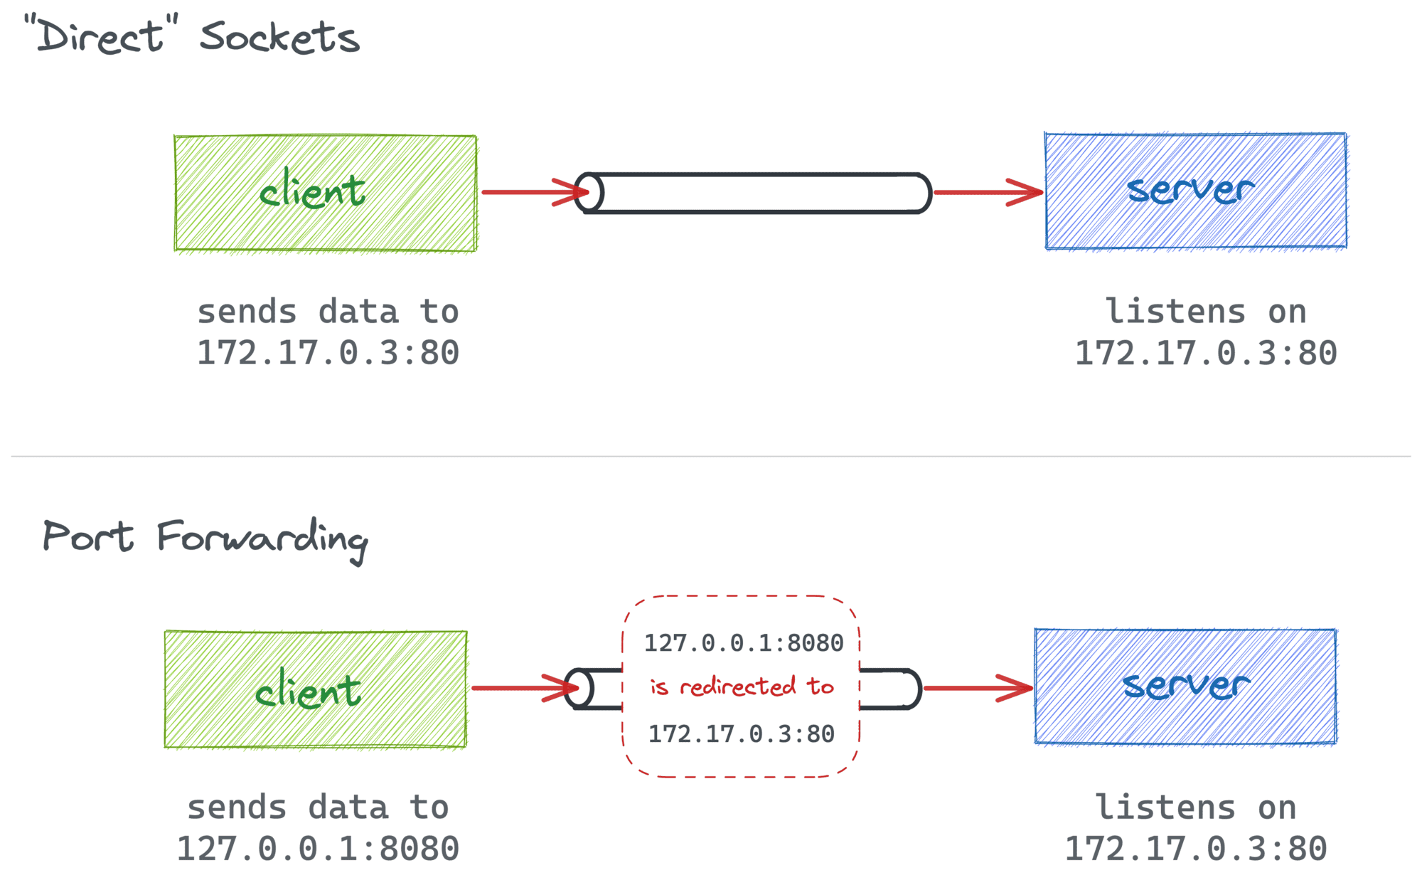
What is port mapping in Docker? "docker run –p 80:8080 <image>"
Port forwarding or, as it's also called, port mapping is just a way to say that data addressed to one socket is redirected to another by an intermediary (for instance, by a network router or a proxy process).

Slide 38
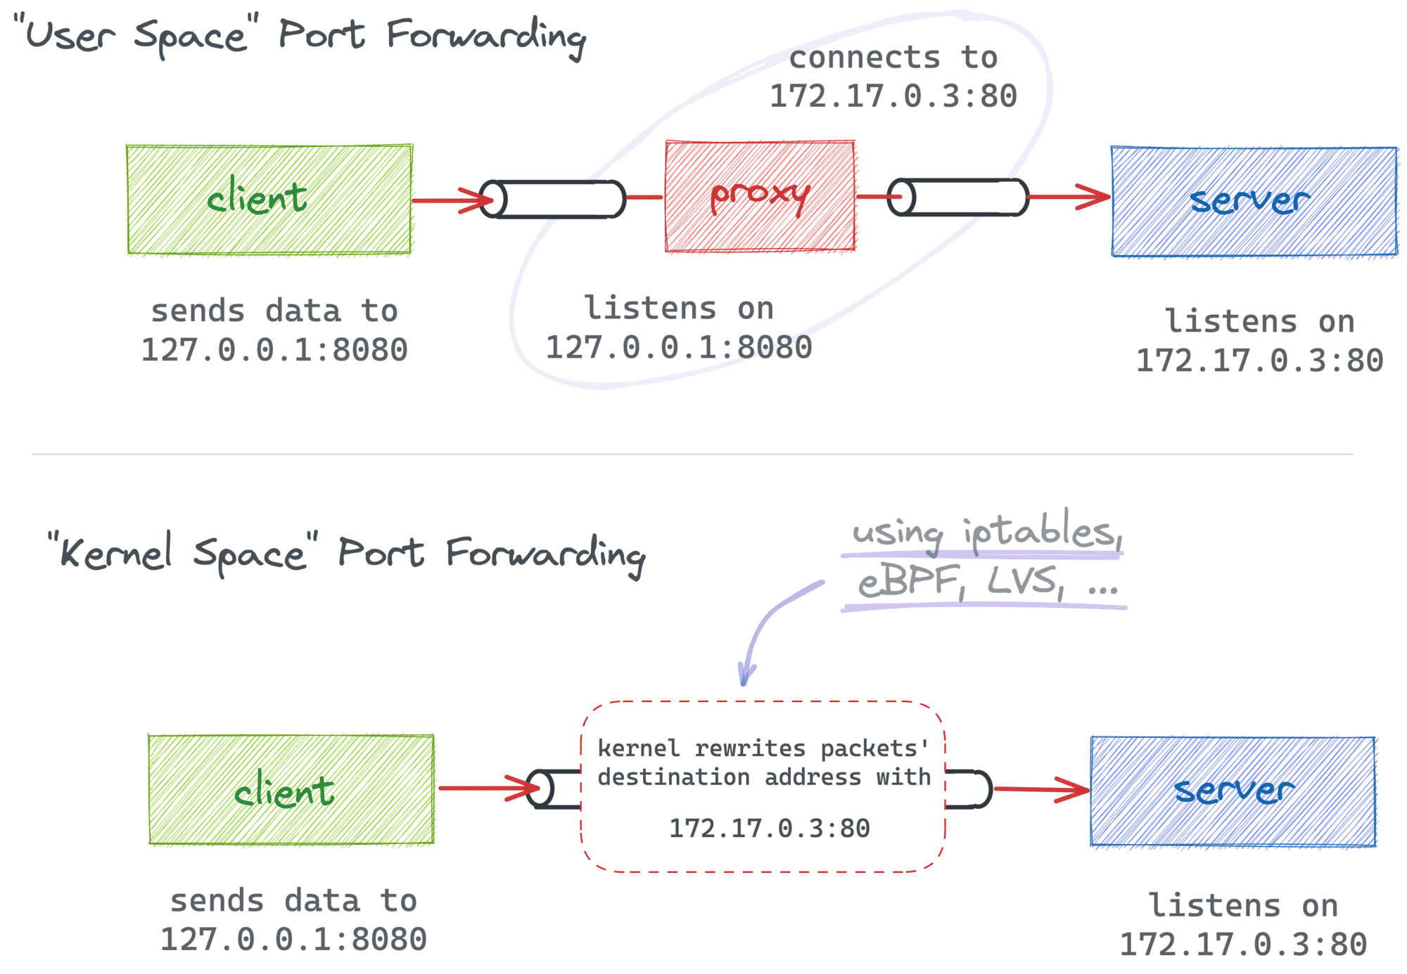
Proxy vs Kernel Port Forwarding
There are two common ways to redirect network data (hence, implement port forwarding):
By sneakily modifying the destination address of packets.
By explicitly putting a proxy between the client and the serv

Slide 39
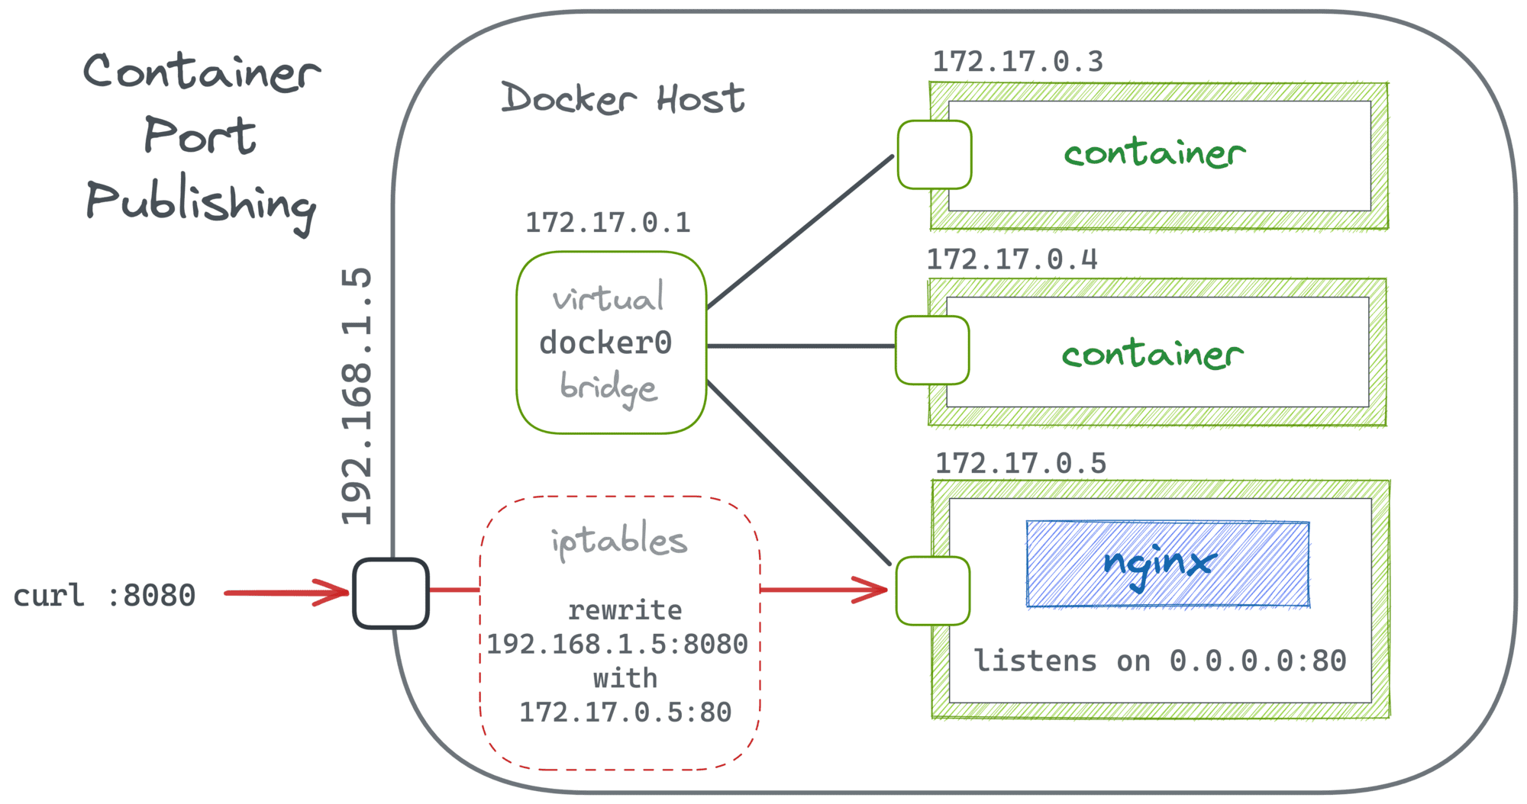
Containers and Port Forwarding
docker run --publish 8080:80 nginx command creates a regular port forwarding from the host's 0.0.0.0:8080 to the container's $CONT_IP:80
in the case of Docker Engine, there is not much difference between port publishing and good old kernel space port forwarding

Slide 40
References
https://iximiuz.com/en/posts/docker-publish-container-ports/
https://iximiuz.com/en/posts/container-networking-is-simple/

